Slide 1
Stealth Industry Visualization
Presented by Joy Chang

Slide 2
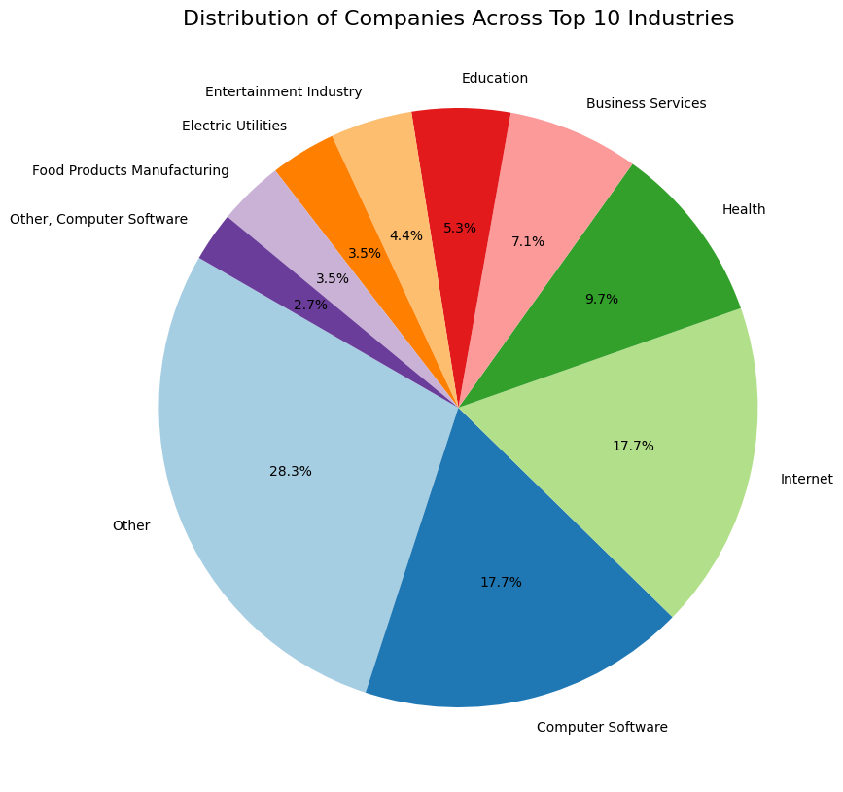
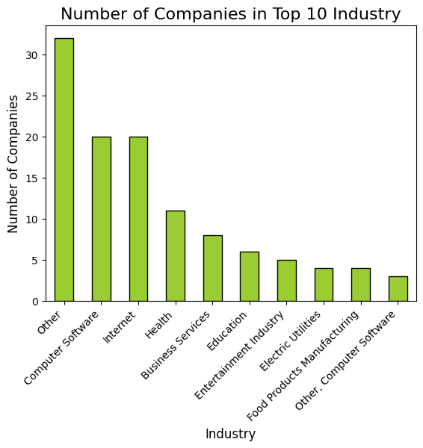
Top 10 industries (Bar and pie)

Slide 3
Top 10 industries
Illustrate the number and spread of the startups in top 10 industries
Other, Internet, and Computer Software account for over 60% of the startups in the top 10 industries
High influence on the Stealth startup ecosystem
The Stealth startups prefer to choose STEM industries
Focusing on technology-driven solutions and innovation
The Stealth startups are in diverse industries
I couldn’t include the data of all the startups when making the plots since there are too many industries
Drawback: treat each startup's industry as a whole – do not break down details for startups spanning multiple industries

Slide 4
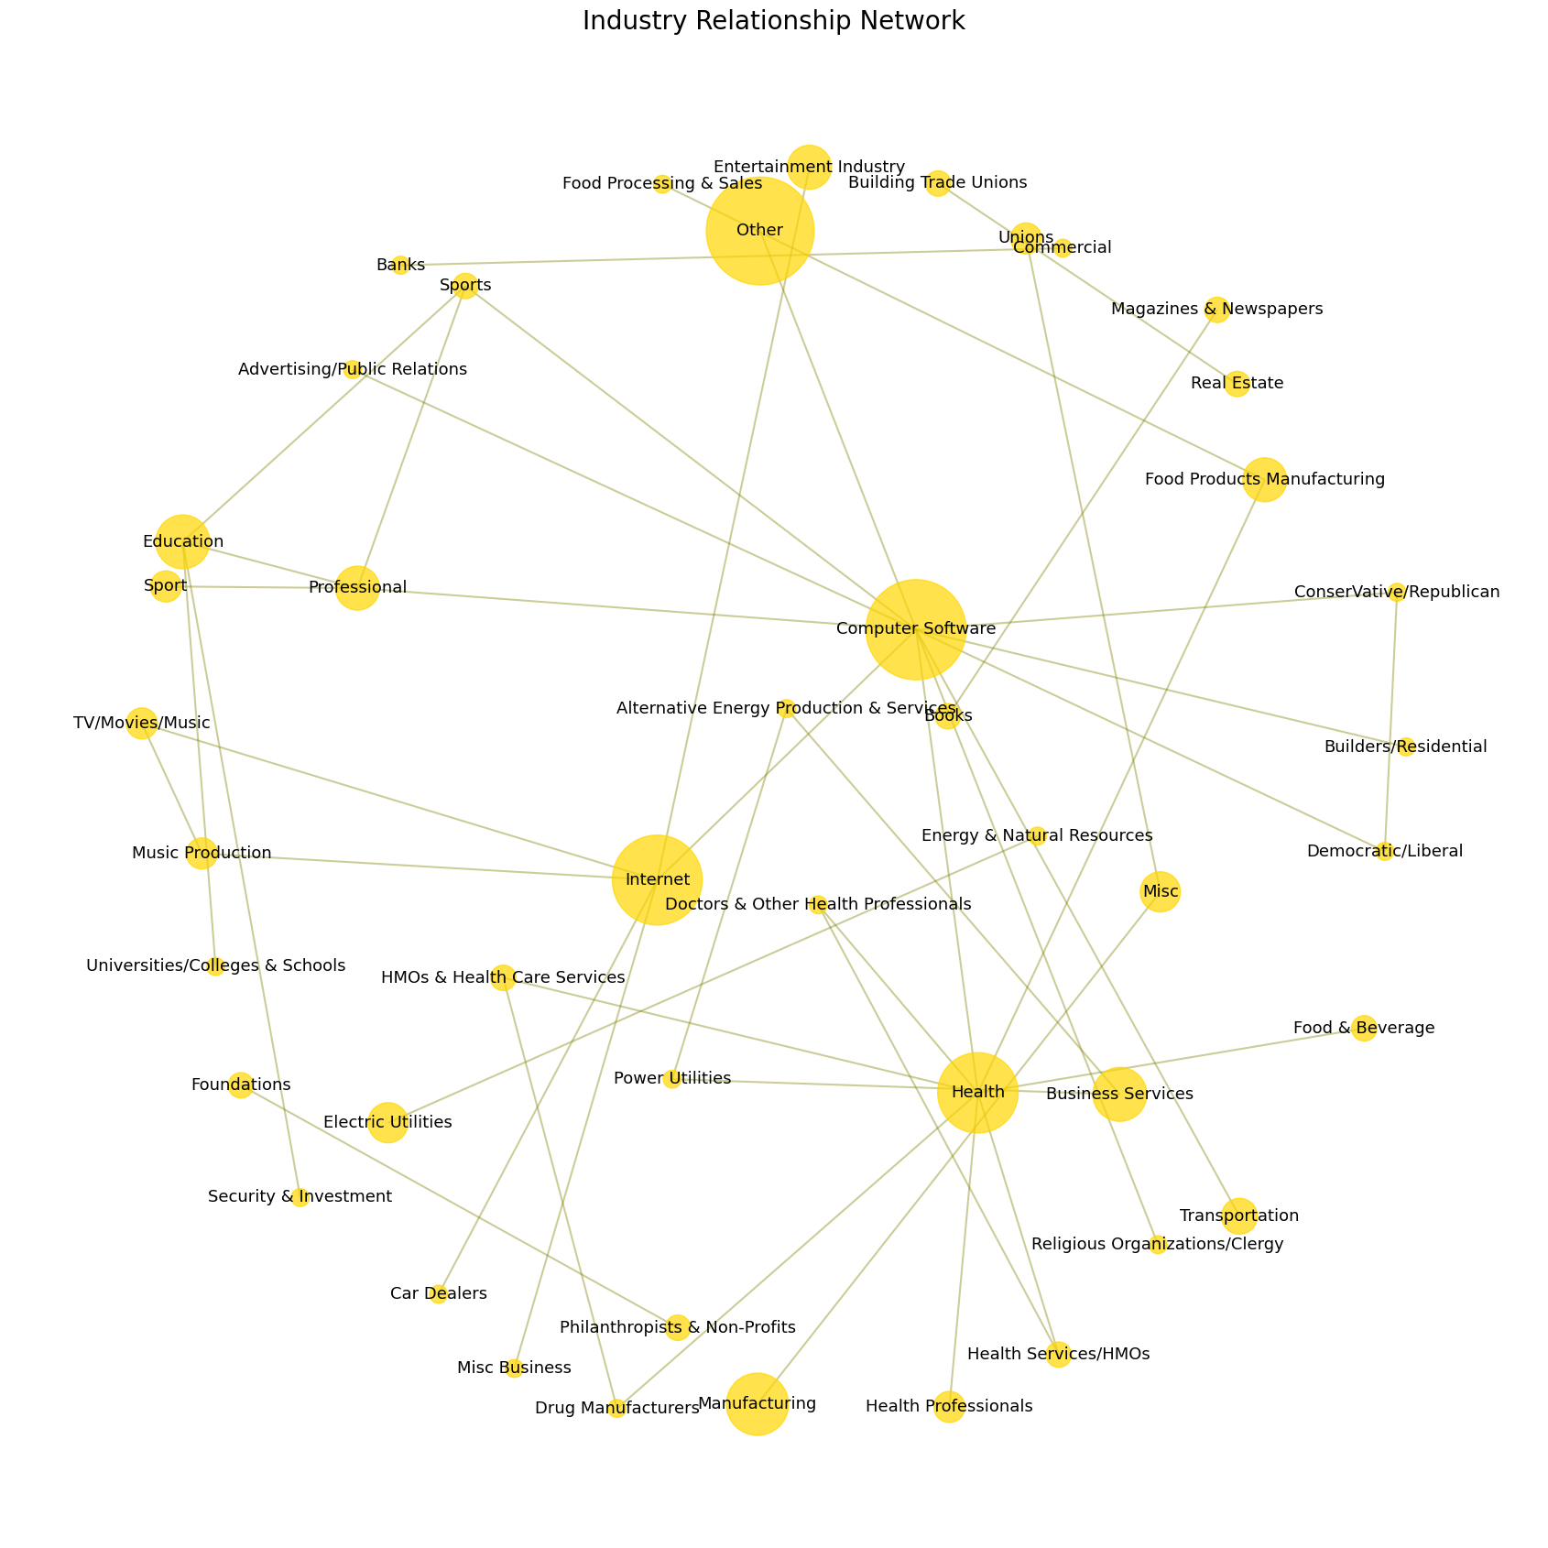
Industry relationship (Network)
Largest nodes and interconnections
Other, Health, Internet, Computer Software
Central to the network and have the most connections to other industries
Significant overlap between industries
Peripheral nodes
E.g. Car Dealers, Philanthropists & Non-Profits, Building Trade Unions
More specialized and niche sectors
Clusters
Industries with similar characteristics E.g. the Health cluster includes Health Professionals, Health Services/HMOs, and Doctors & Other Health Professionals

Slide 5

Industry Frequency (word cloud)
Clear, visual appealing illustration of the industry frequency
The font size variation conveys the relative significance of each industry
The distinguishable font colors and consistent spacing makes it highly readable
Provides a high-level overview of the Stealth startups and their industries
The highly frequent industry words are Health, Services, and Manufacturing
E.g. Business Services, Health Care Services, Food Products Manufacturing, Electronic Manufacturing

Slide 6
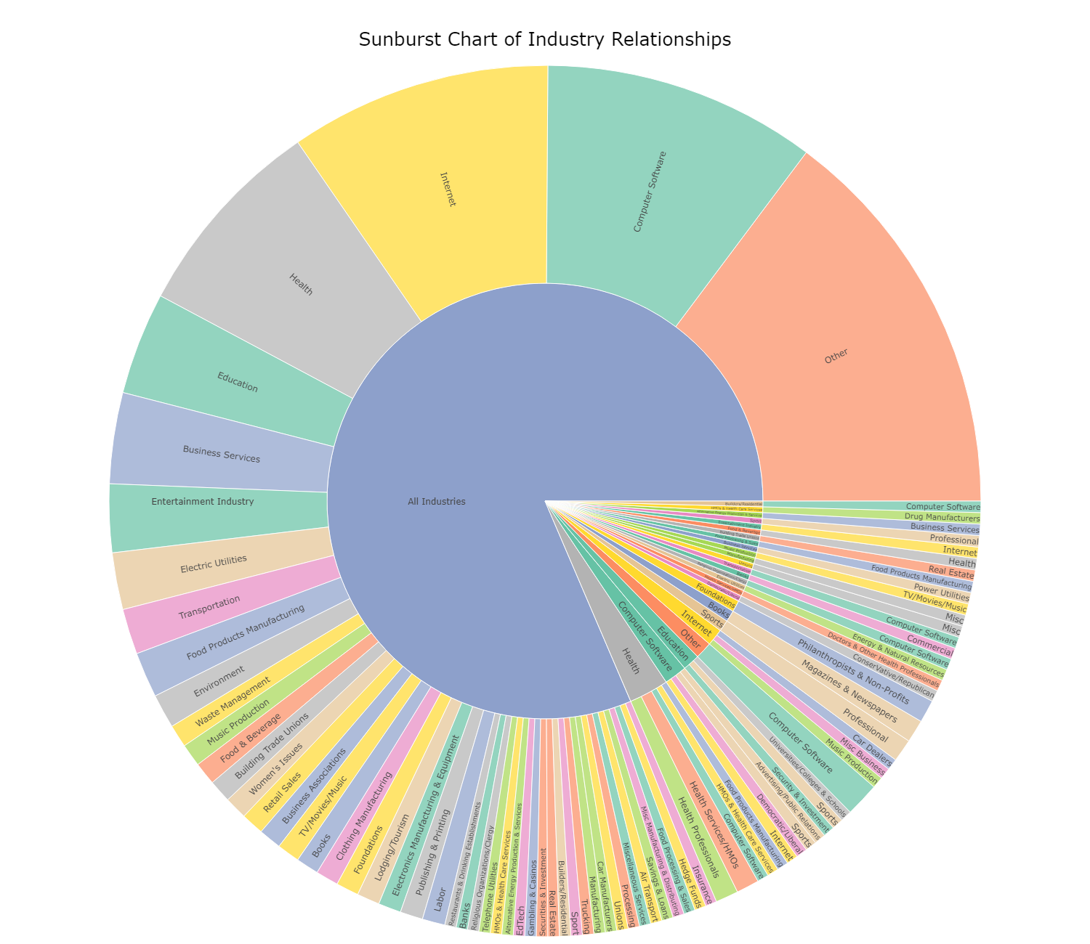
industry relationship (sunburst)
Hierarchical structure
Breaks down the startups by industry
Broad categories (inner layer) branch into subcategories (outer layers)
Breadth of startup diversity
The Stealth startups span various industries
The colored segments differ in size, highlighting which industries dominate

Slide 7
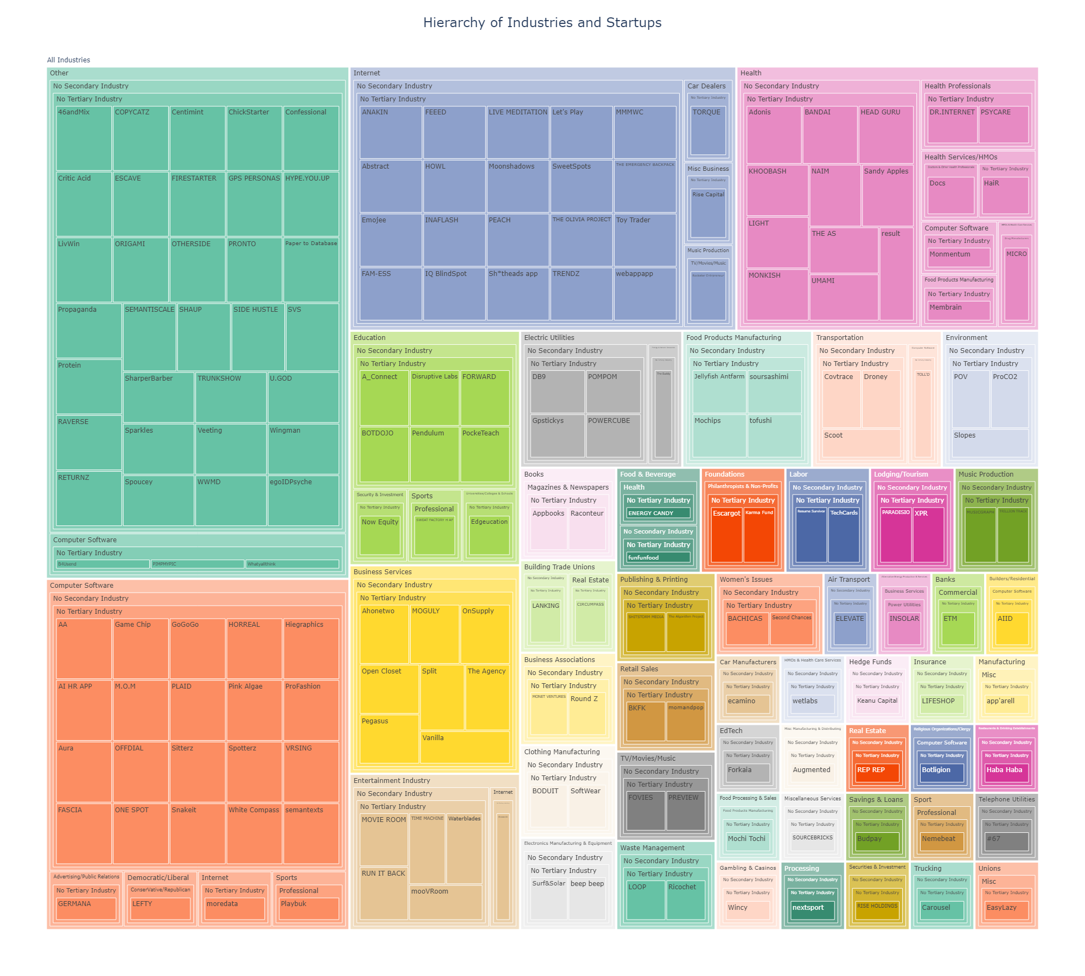
Hierarchy representation (tree map)

Slide 8
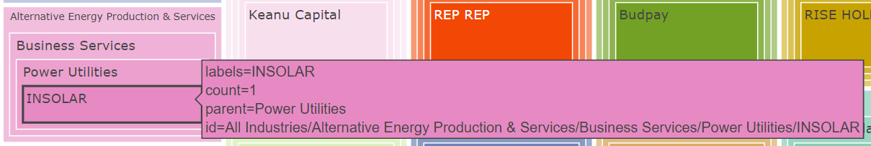
Hierarchy representation (tree map)
Displays the hierarchy of industries and startups
Starts from all industries
Narrows down to primary industry, secondary industry, tertiary industry, and companies
The primary, secondary, tertiary industries are identified by the comma
E.g. Alternative Energy Production & Services → Business Services → Power Utilities → INSOLAR
Color coding
Quick identification of industry groupings
Contains a lot of information yet the map is compact

Slide 9
You are welcome to check my code and data in my GitHub repository and generate clearer, interactive charts using the code!

